Slide 1




Presented by
Managed Care Partners Inc. on behalf of
Clay County Hospital
The ABCs of Medicare & Medicare Advantage

Slide 2


Today’s Topics
Decisions, Decisions, Decisions!
Medicare Enrollment Period
Four Parts of Medicare A, B, C & D
Medicare Advantage – Replacement of Medicare
Comparison of Original Medicare with Medigap Plan & Medicare Advantage
Medicare Part D & Medicare Advantage Rx
Different ID cards, what is important?

Slide 3
Decision Calendar
September 15, 2025 | Plan Annual Notice of Change – (ANOC) The ANOC includes any changes in coverage, costs, and more that will be effective in January.
October 1, 2025 | Start comparing your current coverage with other options.
October 15 to December 7, 2025 Annual Enrollment Period (AEP) | If it makes sense, change your Medicare health and prescription drug coverage. This includes returning to Original Medicare or joining a Medicare Advantage plan.
January 1, 2026 Effective Date | New coverage begins if you made a change. If you kept your current plan, cost and benefit changes, if any, are also effective January 1.
January 1 to March 31, 2026 Open Enrollment Period (OEP) | Only if you are in a Medicare Advantage plan, you can make one change to a different plan or return to Original Medicare and join a stand-alone Rx plan. Changes will be effective on the first of the month after the plan receives your request.

Slide 4
Two Roads to Medicare
Which works best for you?
Evaluate Your Options
Original Medicare
Medicare
Health Plans
Decide if You Want Rx Coverage
Decide if You Want Rx Coverage
Decide if You Want Medigap

Slide 5
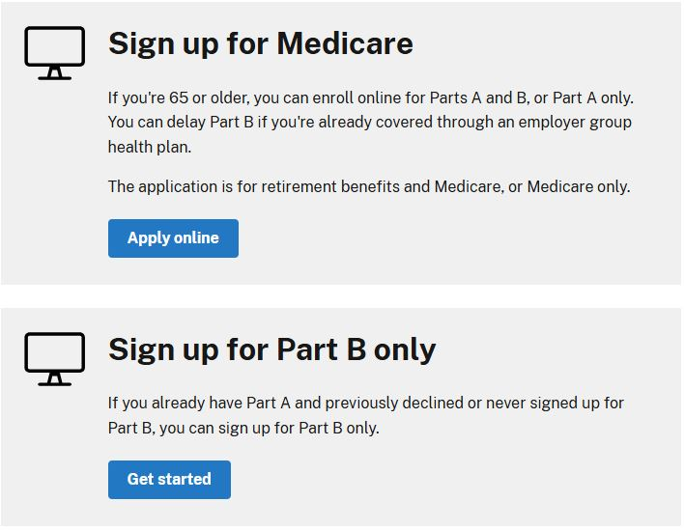
Enrolling in Medicare
https://www.ssa.gov/medicare/sign-up

Slide 6
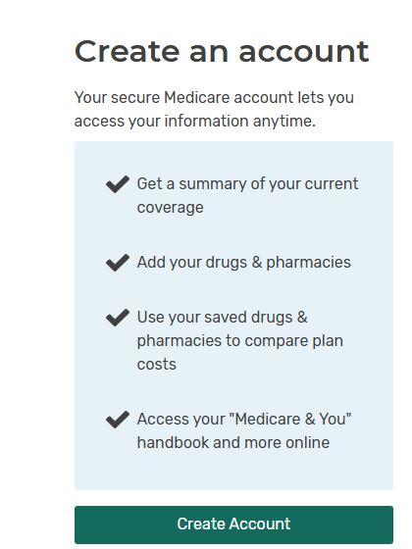
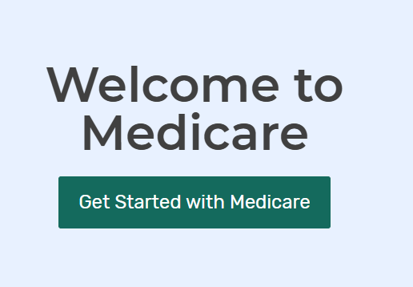
Enrolling in Medicare
https://www.medicare.gov

Slide 7
Four Parts of Medicare Coverage
Three Parts to Original Medicare
A , B, and D
Part A = Inpatient hospital services
Part B = Outpatient services
Part D = Retail Prescription Drug
Part C = Medicare Advantage plans
Replaces Original Medicare A, B and usually D, you cannot use a Medigap or retiree plan

Slide 8
Medigap Plan Options
Filling the GAPS or Supplement Original
Medicare Coverage
Ten Standardized Medigap Plans: A, B, C, D, F**, G*, K, L, M, N
**Plan F only available if your 65th birthday occurred before 1/1/2020
You can use an employer or government retiree program as a “gap” plan
Price and customer service is the difference

Slide 9
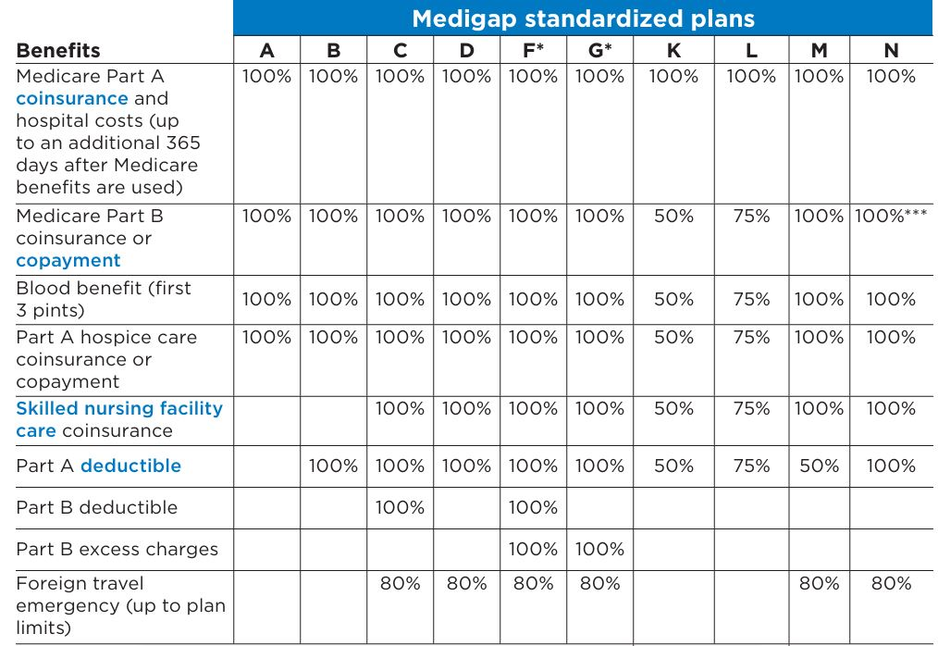
Medigap Plan Options

Slide 10
Medigap Plan Options
Additional Plan Details
*Plans F and G also offer a high-deductible plan in some states. You must pay Medicare-covered costs (coinsurance, copayments, and deductibles) up to the deductible amount of $2,870 in 2025 before policy pays anything.
You cannot buy Plans C and F if you were new to Medicare on or after January 1, 2020.
Visit https://www.medicare.gov for latest amounts.

Slide 11
Medigap Plan Options
Additional Plan Details
Out of Pocket Limit in 2025** Plan K $7,220. Plan L $3,610
** For Plans K and L, after you meet your out-of-pocket yearly limit and your yearly Part B deductible ($288) in 2026, the Medigap plan pays 100% of Covered services for the rest of the calendar year.
***Plan N pays 100% of the Part B coinsurance. You must pay a copayment of up to $20 for some office visits and up to a $50 copayment for emergency room visits that don’t result in an inpatient admission.
Visit https://www.medicare.gov for latest amounts.

Slide 12
Part C Medicare Advantage
Medicare Advantage Plans
Another way to get your Medicare Part A and Part B coverage. Offered by Private companies that must follow rules set by Medicare.
Part C = Medicare Advantage plans
Replaces Original Medicare A, B and usually D, you cannot use a Medigap or retiree plan

Slide 13
Four Parts of Medicare Coverage
Medicare Advantage Plans
Medicare Advantage + Stand Alone Part D
Medicare Advantage + a Medigap Plan
Medicare Advantage Plans may offer extra benefits that Original Medicare doesn’t include.
  Dental, Vision, Hearing. But…read fine print!

Slide 14
Part C Medicare Advantage
Annual Notice / Evidence of Coverage
Important! Read the information you get from your plan
If you’re in a Medicare Advantage Plan or a Part D Prescription Drug Plan (PDP) , review the “Annual Notice of Change” and “Evidence of Coverage” provided by your plan each year.
Annual Notice of Change: Includes any changes in coverage, costs, and more that will be effective in January. Your plan will send you a printed copy by September 30.
Evidence of Coverage: Gives you details about what the plan covers, how much you pay, and more in the next year. Your plan will send you a notice (or printed copy) by October 15. It will include information on how to get it electronically or by mail.
If you don’t get these important documents, contact your plan.

Slide 15
Part C Medicare Advantage
What are the different types of Medicare Advantage Plans?
Health Maintenance Organization (HMO) Plan
HMO Point-of-Service (HMO POS) Plan
Medical Savings Account (MSA) Plan
Preferred Provider Organization (PPO) Plan
Private Fee-for-Service (PFFS) Plan
Special Needs Plan (SNP)

Slide 16
Part C Medicare Advantage
  Special Needs Plan (SNP) Medicare Advantage
  Plans available for people who qualify based on their health or care requirements.
    Chronic Condition SNP (C-SNP) Specific severe or disabling Chronic Conditions
    Dual Eligible SNP (D-SNP) beneficiaries eligible for both Medicare and Medicaid
    Institutional SNP (I- SNP) People who live in long term care facilities or live in a community but require a high level of nursing home care at home.

Slide 17
Provider and Hospital
Network Participation
Original Medicare
Majority of Hospitals and Providers participate with Medicare https://www.medicare.gov/care-compare
In most cases you don’t need a referral to see a specialist
Emergency care is the same across all states
Out of state coverage as long as Medicare participation

Slide 18
Provider and Hospital
Network Participation
Medicare Advantage
Many hospitals and Providers do not participate with Medicare Advantage Plans
Must confirm provider participation through insurance company websites
HMO plans exclude coverage for out of network providers and hospitals except for Emergency care
You may need to get a referral to see a specialist
Limited Travel or out of state coverage except for Emergency care

Slide 19
“Pay me now or Pay me later.”
Original Medicare
Part B Premium $206.50 for most beneficiaries
Monthly cost for medigap plan chosen
Part A deductible paid by medigap plan
Part B deductible of $288 paid annually
Part D deductible $615 plus 25% coinsurance to maximum out of pocket of $2,100.
Maximum out of pocket; paid premium, plus
Part B deductible. Except High Deductible
Plan G $3,538, Plan K $7,220, Plan L $3,610
Medicare Advantage
Part B Premium $206.50 for most beneficiaries
Potential zero premium plans
No deductibles
Copays generally range from $0 to $250
Maximum out of pocket (MOOP) is $9,250. but may be lower for some plans. PPO plans must cap MOOP at $10,600 combined for in or out of network services.

Slide 20
What is the actual cost of care?
Original Medicare
Part A – Most Medi-gap plans pay 100% of care along with Medicare.
Part B –covered services, you usually pay 20% of Medicare- approved amount after you meet the deductible.
Medicare Advantage
Part A - is subject to daily copays up to a maximum number of days (5-7) admitted; depending on plan purchased.
Part B - Out-of-pocket costs vary – plans may have lower or higher out-of-pocket costs for certain services.

Slide 21

Membership in Medicare Advantage
You are not required to join a Medicare Advantage plan & may stay on Original Medicare.
There is no penalty if you do not join a Medicare Advantage plan.
You decide & control if or when you join.
To join a Medicare Advantage plan, you must have Medicare Part A and Part B, live in the plan’s service area & except for Special Needs Plans, not have ESRD (End Stage Renal Disease).

Slide 22

Medicare Part D – Prescription Drugs
Medicare Part D Retail Pharmacy Coverage

Slide 23

Medicare Part D 2026
Annual Deductible: The standard Part D deductible will be $615, an increase of $25 from 2025.
Out-of-Pocket (OOP) Spending Cap: The maximum
amount you'll pay for prescription drugs out-of-pocket
in a year will be $2,100 in 2026.
Catastrophic Coverage: When the $2,100 out-of-
pocket limit is reached, all covered Part D drugs are
provided at no cost to the beneficiary for the rest of the
plan year.

Slide 24
Medicare Part D 2026
Copayments or coinsurance:
These are the amounts you pay for covered drugs after
you meet the plan’s deductible,(if the plan has one).
You pay your share, and your plan pays its share for
covered drugs. If you pay coinsurance, these amounts
may vary because drug plans and manufacturers can
change what they charge at any time throughout the
year.
Insulin Cost-Sharing:
The cost-sharing amount for covered insulin products
will remain low, at $35 or 25% of the maximum fair price.

Slide 25
Medicare Part D 2026
Covered drugs: All plans must cover a wide range of prescription drugs that people with Medicare take, including most drugs in certain “protected classes,” like drugs to treat cancer, HIV/AIDS, depression, psychosis, seizures, or to prevent organ transplant rejection.
Formulary: Information about a plan’s list of covered
drugs (called a “formulary”). Follows Medicare
guidelines.
Before joining a plan, be sure to review its formulary.

Slide 26
Medicare Part D 2026
Drug Tiers The cost-sharing levels with a Part D plan formulary.
Tier 1: Preferred Generic Drugs
Tier 2: Non-preferred generic and some low-cost
brand-name drugs
Tier 3: Preferred brand-name drugs
Tier 4: Non-preferred brand-name drugs
Tier 5: High-Cost drugs or “specialty Drugs”

Slide 27
Medicare Prescription Payment Plan
The Medicare Prescription Payment Plan This payment option works with your current drug coverage to help you manage your out-of-pocket costs for drugs covered by your plan by spreading them across the calendar year (January–December). This payment option might help you manage your expenses, but it doesn’t save you money or lower your drug costs
If you select this payment option, each month you’ll continue to pay your plan premium (if you have one), and you’ll get a bill from your health or drug plan to pay for your prescription drugs (instead of paying the pharmacy). All plans offer this payment option, participation is voluntary, and there’s no cost to participate in the Medicare Prescription Payment Plan.
Beginning in 2026, participating plans will automatically re-enroll individuals unless they specifically opt out. If you change to a different Medicare plan, you will need to opt-in to the payment plan again with your new insurer to continue.

Slide 28
Extra Help – Low Income Subsidy (LIS)
Low Income Subsidy (LIS) helps people with Medicare pay for prescription drugs and lowers the costs of Medicare Prescription drug coverage.
Who qualifies? People who have limited income and resources may still qualify for Extra Help, but they must apply to find out.
Apply online for Medicare Part D Extra Help program
https://www.ssa.gov/medicare/part-d-extra-help
This program is more advantageous than the new Medicare Prescription Payment Plan.

Slide 29

Medicare Drug Coverage (Part D)
Late Enrollment Penalty
3 ways to avoid paying a penalty:
Enroll in Medicare drug coverage when you are first eligible.
Enroll in Medicare drug coverage if you lose other creditable coverage.
Keep records showing when you had other creditable drug coverage and tell your plan when they ask about it.

Slide 30

Medicare Advantage &
Medicare Part D
If you have a Medicare Advantage HMO or PPO, you may not have a stand-alone prescription drug plan even if your HMO or PPO does not include Rx coverage.
If you have a Medicare Advantage HMO or PPO and you enroll in a stand-alone prescription drug plan, your Medicare Advantage plan will automatically be terminated.

Slide 31

If You Want to Bail Out …
Special Enrollment Periods
Special rules on joining or switching apply if:
  You move out of the plan’s service area
  You have both Medicare and Medicaid
  You qualify for Extra Help
  You move into, live, or move out of a skilled nursing facility
  You disenroll from an employer group health plan
  You switch to a 5-Star Medicare Advantage plan

Slide 32
If You Want to Bail Out …
Special Enrollment Periods
Medicare Advantage Open Enrollment Period
  If you are enrolled in a Medicare Advantage Plan, after January 1, you may move back to Original Medicare or switch to a different Medicare Advantage plan if you do so before March 31st.
Beginning April 1st, you are “locked-into” a plan until the next Annual Enrollment Period.

Slide 33
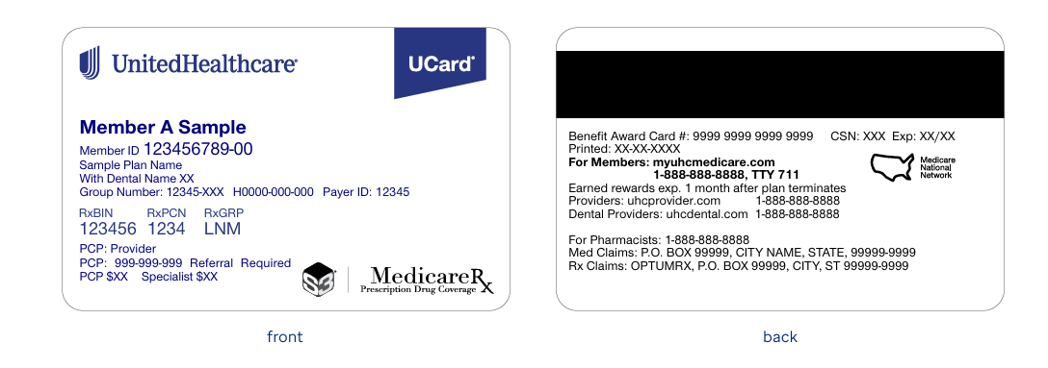
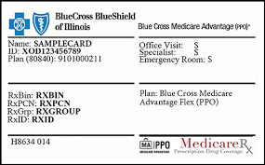
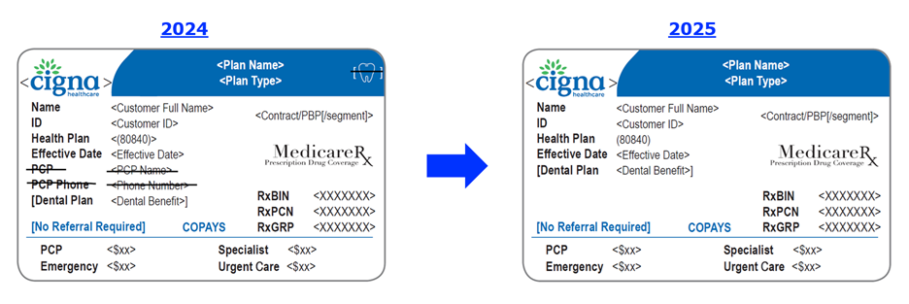
Medicare Advantage ID Cards

Slide 34
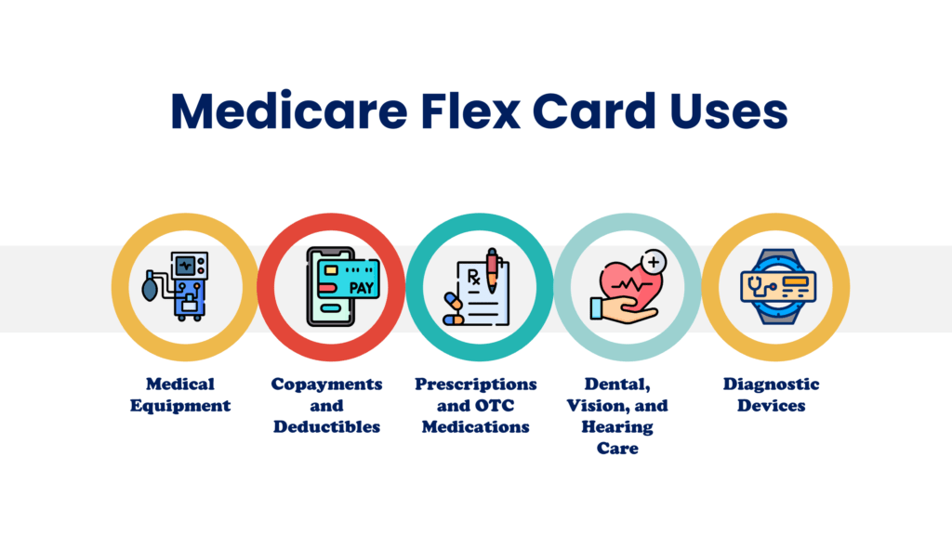
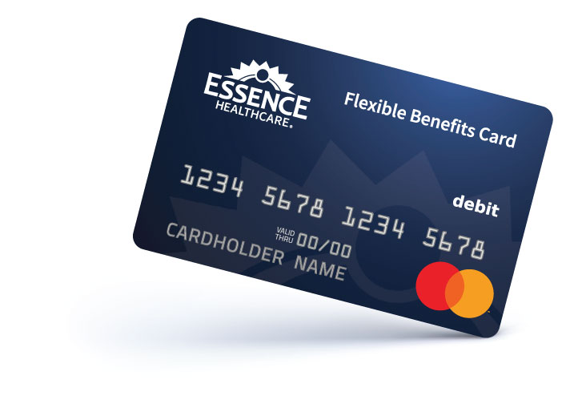
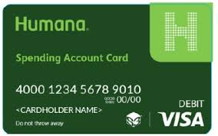
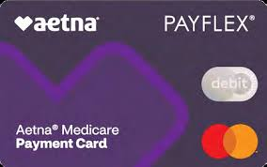
Spend Account Cards

Slide 35
Identity Theft and Fraud

Slide 36
Identity Theft and Fraud
Important!
Medical identity theft is when someone steals or uses your personal information (like your name, Social Security Number, or Medicare Number) to submit fraudulent claims to Medicare and other health insurance companies without your permission. When you get health care services, record the dates on a calendar and save the receipts and statements you get from providers to check for mistakes.
If you’ve contacted the provider and you suspect that Medicare is being charged for a service or supply that you didn’t get, or you don’t know the provider on the claim, call 1-800-MEDICARE.

Slide 37
Identity Theft and Fraud
Important!
Call 1-800-MEDICARE to report any plans or agents that:
Ask for your personal information over the phone or email
Call to enroll you in a plan
Visit you unexpectedly
Use false information to mislead you
You can also call the Medicare Drug Integrity Contractor (MEDIC) at 1-877-7SAFERX (1-877-772-3379). The MEDIC fights fraud, waste, and abuse in Medicare Advantage Plans and

Slide 38
Helpful Links:
https://claycountyhospital.org
https://www.medicare.gov
https://www.ssa.gov
https://ilaging.illinois.gov/ship.html (Illinois)

Slide 39


Thank You

